Slide 1
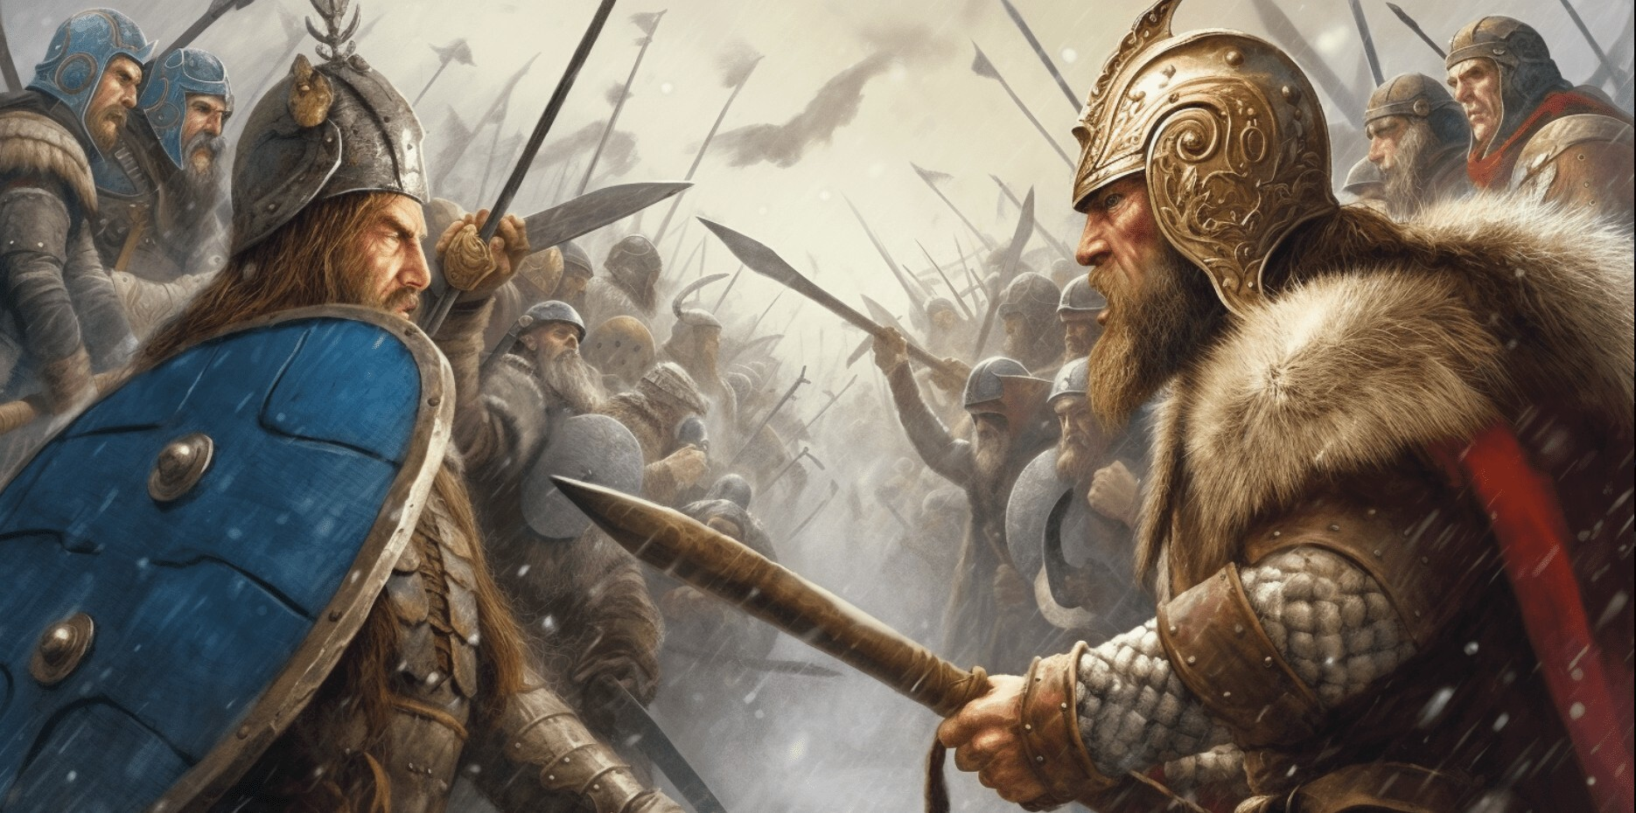
A Clash of Classes:
Simulating War in Python!
Vikings-Mini-Project
— — — — — — — —
Jithin Kumar
Katherine Torian
Anirudh Unni

Slide 2
Simulating a Battle
Imagine a video game where characters fight.
Each character has health (how much damage they can take) and strength (how much damage they can deal).
We need a way to represent different types of characters (like Vikings and Saxons).
Python's classes are perfect for this!

Slide 3
Classes - Blueprints for Things
Class: A blueprint or a template. It defines the common traits and actions for a category of things.
Analogy: The architectural plan for a house.
Object: An actual, individual item built from that blueprint.
Analogy: Your specific house, built from the house’s plan.
Why use them? They help us organize our code and represent real-world (or fantasy-world!) concepts.
In our project, the class (or blueprint!) would be Soldier, as all vikings and saxons have a Soldier’s characteristics. The objects would be the two different clans, vikings and saxons, having some different characteristics.

Slide 4
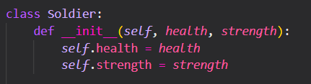
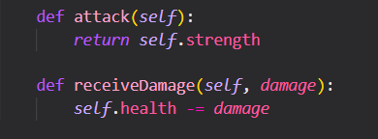
Our Basic Fighter: The Soldier
This is the most fundamental blueprint for any fighter in our game. This means this is our parent class.
What it HAS (Attributes/Data):
health: How much life they have.
strength: How powerful their attacks are.
What it CAN DO (Methods/Actions):
attack(): Returns how much damage they deal, directly related to the ‘strength’ attribute.
receiveDamage(damage): Lowers their health when being hit, related to the ‘health’ attribute.

Slide 5
Specialized Fighters: Viking and Saxon (Inheritance!)
Main Points:
Instead of starting from scratch, Viking and Saxon inherit from Soldier.
This means they automatically get health, strength, attack(), and receiveDamage() from Soldier.
They can then add their own unique features or change how existing features work.

Slide 6
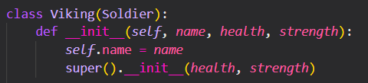

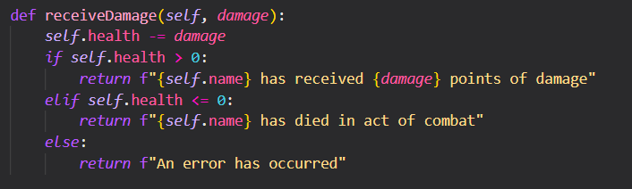
Classes - Vikings
Viking:
Adds a name.
Adds a battleCry() method.
Custom message when receiveDamage() or dies.

Slide 7
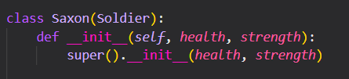
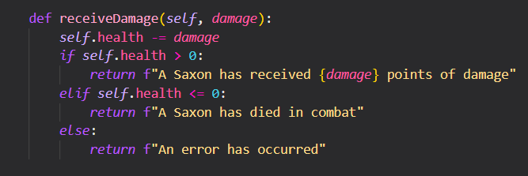
Classes - Saxons
Saxon:
Doesn’t receive a name
Custom message when receiveDamage() or dies.

Slide 8
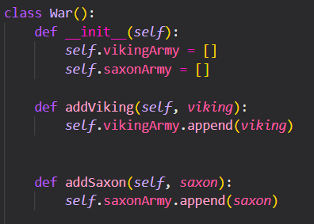
The Battle Commander The War Class
Main Points:
This class acts as our "game master."
What it HAS (Attributes):
vikingArmy: A list to hold all Viking objects.
saxonArmy: A list to hold all Saxon objects.

Slide 9

Simulating the Battle!
Time to place your bets…

Slide 10
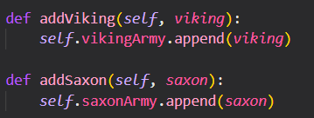
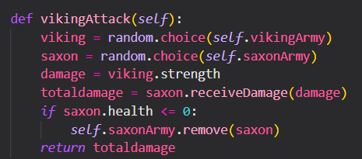
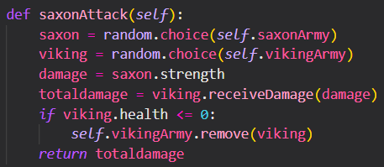
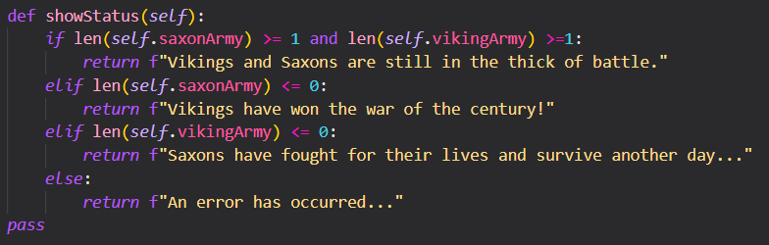
What it CAN DO (Methods/Actions):
addViking() / addSaxon(): Recruit fighters to armies.
vikingAttack(): A random Viking attacks a random Saxon.
saxonAttack(): A random Saxon attacks a random Viking.
showStatus(): Tells us if the battle is ongoing, or who won!

Slide 11
Key Takeaways from Our Battle
Organization: Classes help us structure our code, keeping fighter data and actions separate but connected.
Reusability: We define Soldier once, and Viking and Saxon automatically get its features.
Flexibility: We can easily add new types of fighters (e.g., "Archer," "Knight") without rewriting everything.
Clearer Code: Easily understandable for English speakers (viking.attack(), saxon.receiveDamage()).
Modeling Reality: Classes allow us to represent real-world concepts (like armies and soldiers) in our code.

Slide 12
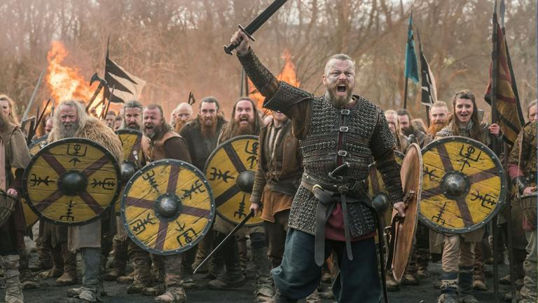
Any Questions, warriors?

